Slide 1
Brain Tumor Segmentation
Project Member:
Faaraan Farid Kazi
Shikshit Gupta

Slide 2
Introduction
Brain tumors are among the most serious and life-threatening forms of cancer, primarily due to their location in the central nervous system. Early and accurate diagnosis and segmentation of brain tumors are vital for effective treatment planning and improved patient outcomes. Segmentation, the process of partitioning a digital image into multiple segments or sets of pixels, is critical in delineating tumor boundaries from normal brain tissues.
Methodology: Recent breakthroughs in artificial intelligence have led to the adoption of machine learning algorithms, particularly deep learning. Convolutional Neural Networks (CNNs) are especially prominent, given their ability to learn hierarchical representations, making them highly effective for image segmentation tasks.

Slide 3
Problem overview
Significance of the Problem:
Automatic brain tumor segmentation is a crucial task in medical image processing.
Achieving a computational model surpassing human-level performance can greatly assist clinicians.
It enables a more precise, reliable, and standardized approach to disease detection, treatment planning, and monitoring.
Prevalence of Gliomas:
Gliomas are the most common type of brain tumors in humans.
Accurately segmenting gliomas is challenging due to their variable shape and appearance in multi-modal MRI.
Challenges in Manual Segmentation:
Manual segmentation of brain tumors requires extensive medical expertise.
The process is time-consuming and prone to human error.
Lack of consistency and reproducibility in manual segmentation negatively impacts results.

Slide 4
Dataset
The BraTS (Brain Tumor Segmentation) dataset is a widely used collection of medical imaging data specifically focused on brain tumor research. It is designed to facilitate the development and evaluation of algorithms for the segmentation and classification of brain tumors in magnetic resonance imaging (MRI) scans
Ref: https://arxiv.org/pdf/2107.02314v1.pdf

Slide 5
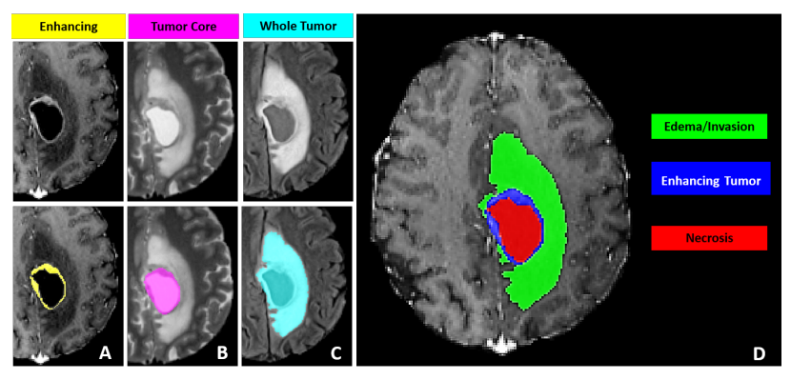
Reference Image
Ref: https://arxiv.org/pdf/2107.02314v1.pdf

Slide 6
It has mean dice score of 83.74% with 450K parametres Ref: https://arxiv.org/pdf/1805.08403v3.pdf
It has mean dice score of 92% with 61.98M parametres. Ref: https://arxiv.org/pdf/2201.01266.pdf
Here we are aiming for less number of parameters with decent dice score.
Autofocus Layer
CNN Based Segmentation
Swin UNETR
OM-NET CGA
Custom-Net
It has mean dice score of 72% Ref: https://arxiv.org/pdf/1701.03056v2.pdf
It has mean dice score of 91.63% with 13.814M parametres Ref: https://arxiv.org/pdf/1906.01796v2.pdf

Slide 7
Conclusion and Future Work
In this study, we offer a unique brain tumor segmentation model, called Custom-Net, that is specifically designed to address the issue of class imbalance and improve the IoU, dice & loss.
Will try to make model more robust and less complex with more accuracy.
Try to improve the model speed with less complex architecture.
With more powerful system in future will try to improve accuracy with less complex architecture.

Slide 8
Thank You!

